Slide 1

Genome annotation comparisons of the Drosophila genus
By Cheukting Law, Changmin Yu and Yusef Paolo Rabiah

Slide 2
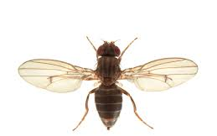
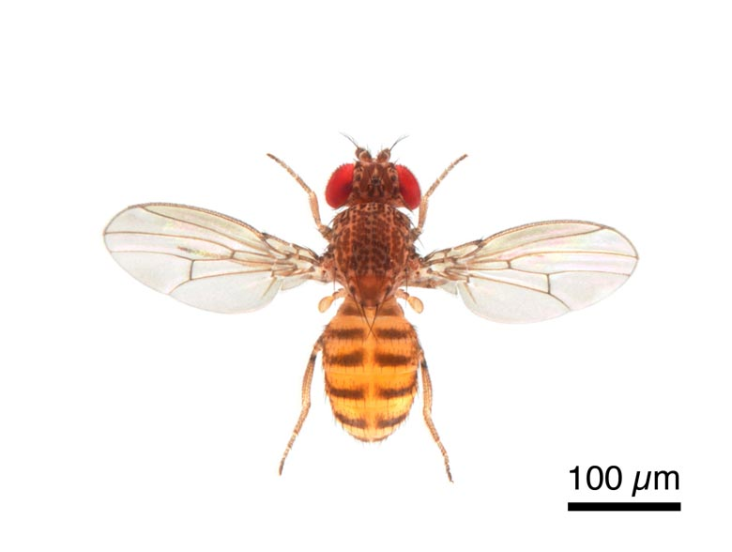
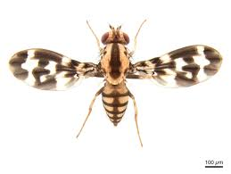
Drosophila species
Species studied:
D. grimshawi, D. virilis and D. mojavensis
Source: Flybase.org
Notes:
All three species were part of a large genome comparative study of 12 fruit flies. (Drosophila 12 Genomes Consortium)

Slide 3
Annotation method: Genscan

Slide 4

Genscan: Ab initio gene prediction
Uses a probabilistic model to scan for core gene structural features within eukaryotic genomic sequences.
These include: promoters, exons, introns, donor and acceptor splice sites.
The model places emphasis on the gene features which are recognised by transcriptional, translational and splicing machinery.
Notes:
Doesn’t focus on specialised signals which are only present in particular genes. Won’t search for gene-specific transcription factor binding sites such as SP1 or E2F.
Focuses on generic core features including the TATA box, cap site and polyadenylation (AAUAAA) signals.
Drosophila core promoter database, 43% of core promoters contain a TATA box.
Restrictions of genscan:
Only protein coding genes are considered (no tRNA or rRNA genes included)
Transcription units are considered to be non-overlapping

Slide 5
Genscan preparation
Before insertion
The Drosophila scaffold FASTA files were split into 800,000 bp scaffolds upon insertion into Genscan.
Data filtering
Low-probability Genscan exon predictions (P < 0.50) are not reliable and have been removed.
Source: Genscan Manual

Slide 6
Genscan results

Slide 7

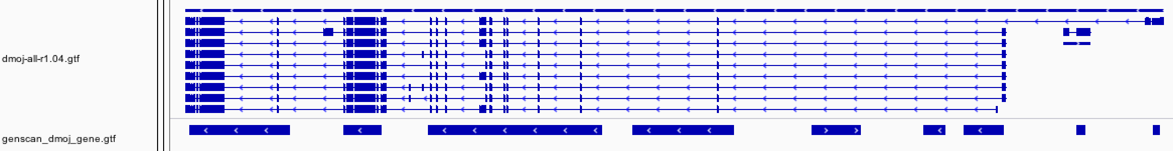
Genscan – Gene number
Key Conclusions:
Genscan overpredicts gene number in all studied Drosophila species.
Reasons:
- Predicts non-existent genes
- Splits long genes into multiple smaller genes
Official gene regions
Predicted gene regions
Official gene regions
Predicted gene regions

Slide 8

Genscan – Gene length
Key Conclusions:
Gene lengths predicted by Genscan are shorter than the official gene lengths for all studied Drosophila species.
Observations:
- Majority of genes have lengths between 700 - 10,000bp.
- Concentration of data points lies slightly above the diagonal.
Reasons:
Genscan cannot predict 5’ and 3’ UTRs.
Log₁₀ (length of official genes)
Log₁₀ (length of official genes)
Log₁₀ (length of Genscan predicted genes)
3’ UTR
5’ UTR
D. mog (official gene)
Genscan gene

Slide 9
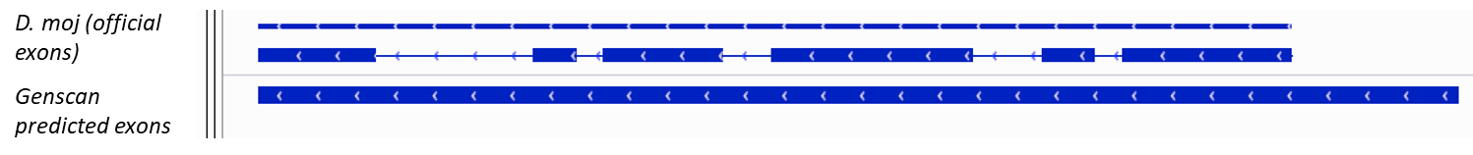
Genscan - Exon number
Key Conclusions:
Total exon number predicted by Genscan is less than the official total exon number for all studied Drosophila species.
Reasons:
- When there is a small intronic gap between two exons, Genscan experiences difficulties in detecting this intron and therefore predicts a single longer exon.
- Genscan has difficulties in resolving isoforms.

Slide 10
Genscan - Exon length
Key Conclusions:
- Predicted length of exons in Genscan has a localised cluster of data points on the diagonal in comparison with the length of the official exons.
Reasons:
- UTRs are not a contributing factor.
Log₁₀ (length of official exons)
Log₁₀ (length of Genscan predicted exons)

Slide 11
Gene number comparison in literature
Drosophila species | Genscan gene predictions | Coding Genes | Our Genscan predictions
D. grimshawi | 21,776 | 14,982 | 17,918
D. virilis | 22,393 | 14,491 | 19,711
D. mojavensis | 22,750 | 14,594 | 18,417
D. melanogaster | 18,548 | 13,918 | N/A
Source: Metazoa Ensembl

Slide 12
Annotation methods: Blastn and tBlastn

Slide 13
BLASTn and tBLASTn
Homology based methods
Query: D. melanogaster transcript and translated files respectively
Target: 3 Drosophila species’ genomes

Slide 14
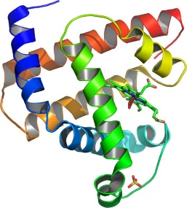
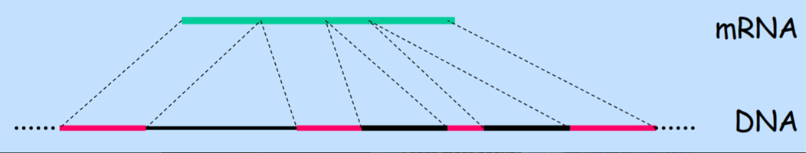
Blastn and tBlastn: Spliced alignment problem
Align mRNA sequences to the genomic DNA sequence of the 3 Drosophila species.
tBlastn
Blastn

Slide 15
Gene prediction from Blastn/tBlastn data
GeneA
100
-
+
200
+
Gene
Strand
Exon cluster
-
4
1
2
3
Scaffold ID
Sum of Bit-score
1580
200
900
400
+
Gene A.1
Gene A.2
Gene A.3
Gene A.2
Sccaffold 100
-
Gene A.2
+
Sccaffold 200
-
Gene A. 1
tblastn/blastn predicted gene

Slide 16
Blastn/tBlastn results

Slide 17
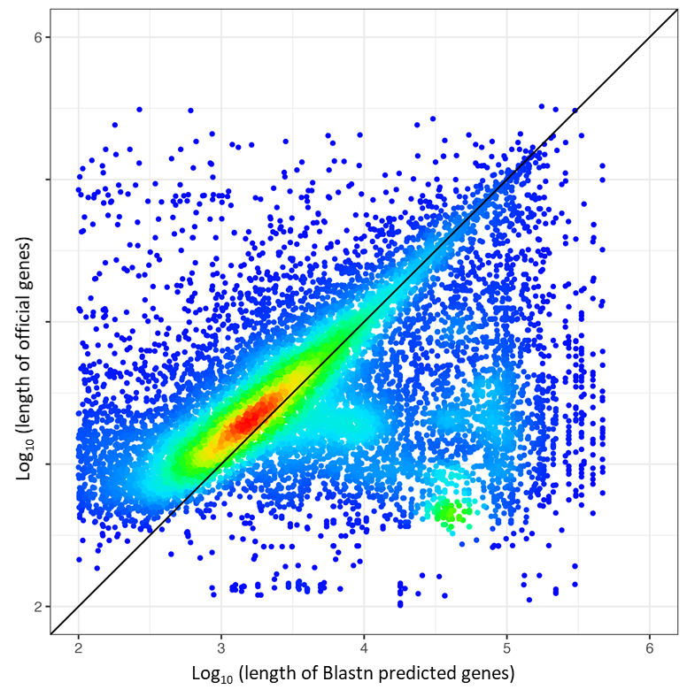
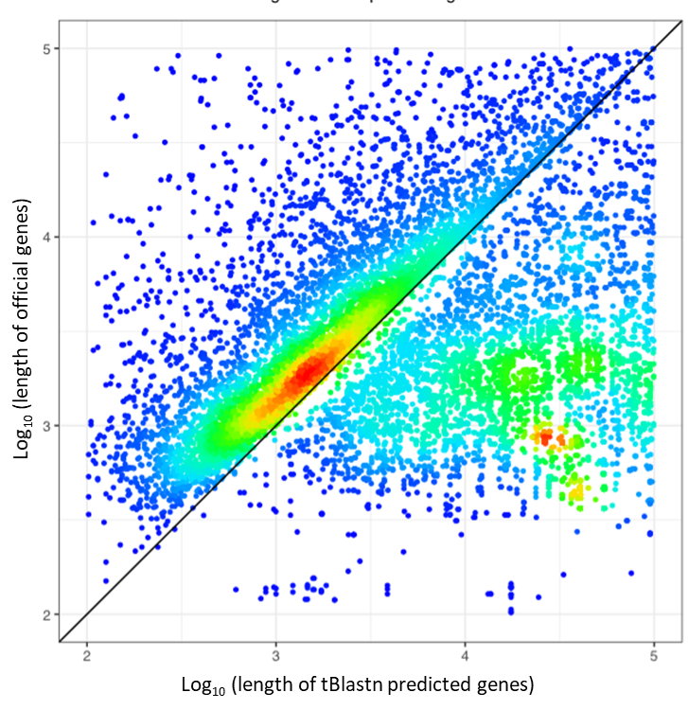
Blastn/tBlastn - Gene length
Key Conclusions:
- Gene lengths predicted using Blastn/tBlastn are shorter than the official gene lengths for all Drosophila species studied.
- tBlastn shows another less intense data point concentration below the diagonal, this indicates that tBlastn predicts longer genes.
Possible Reasons:
- Highly evolved UTRs prevent the sequences from aligning to the Drosophila genomes.
- The initial and terminal exons are not well predicted, shortening the gene length.

Slide 18
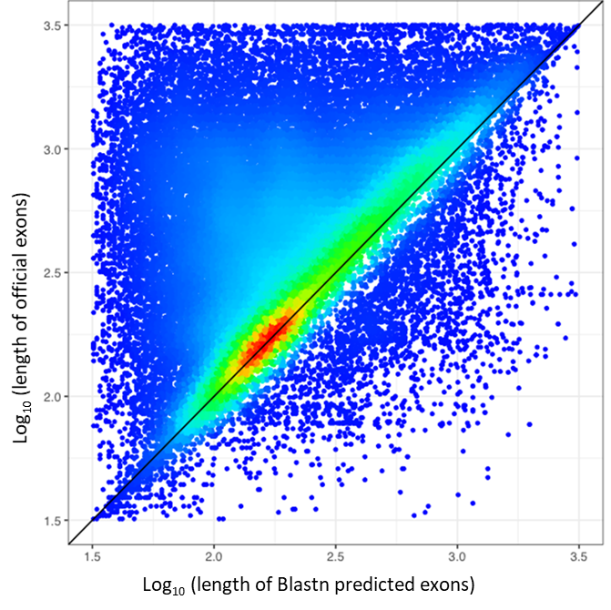
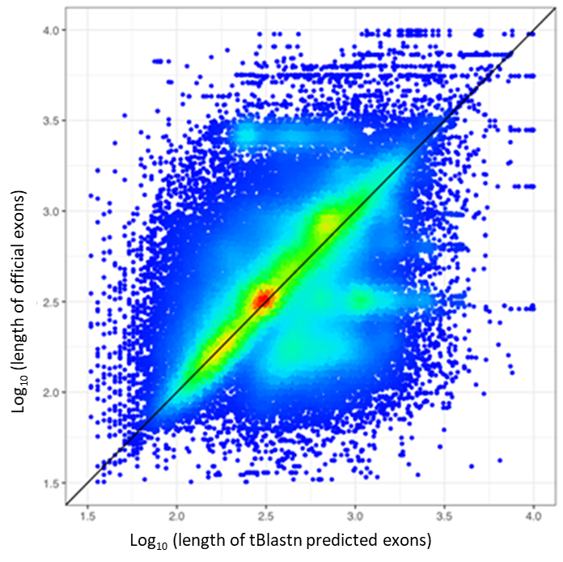
Blastn/tBlastn – Exon length
Key Conclusions:
- Predicted length of exons are more dispersed. The majority of the data points lie on the diagonal.
- tBlastn shows a minor skew towards the longer predicted exon lengths.
Reasons:
Blastn generates multiple non-existent exons
Structure of the exons is not known

Slide 19
Specificity comparisons between annotation methods

Slide 20
Cross-species comparisons between different annotations

Slide 21
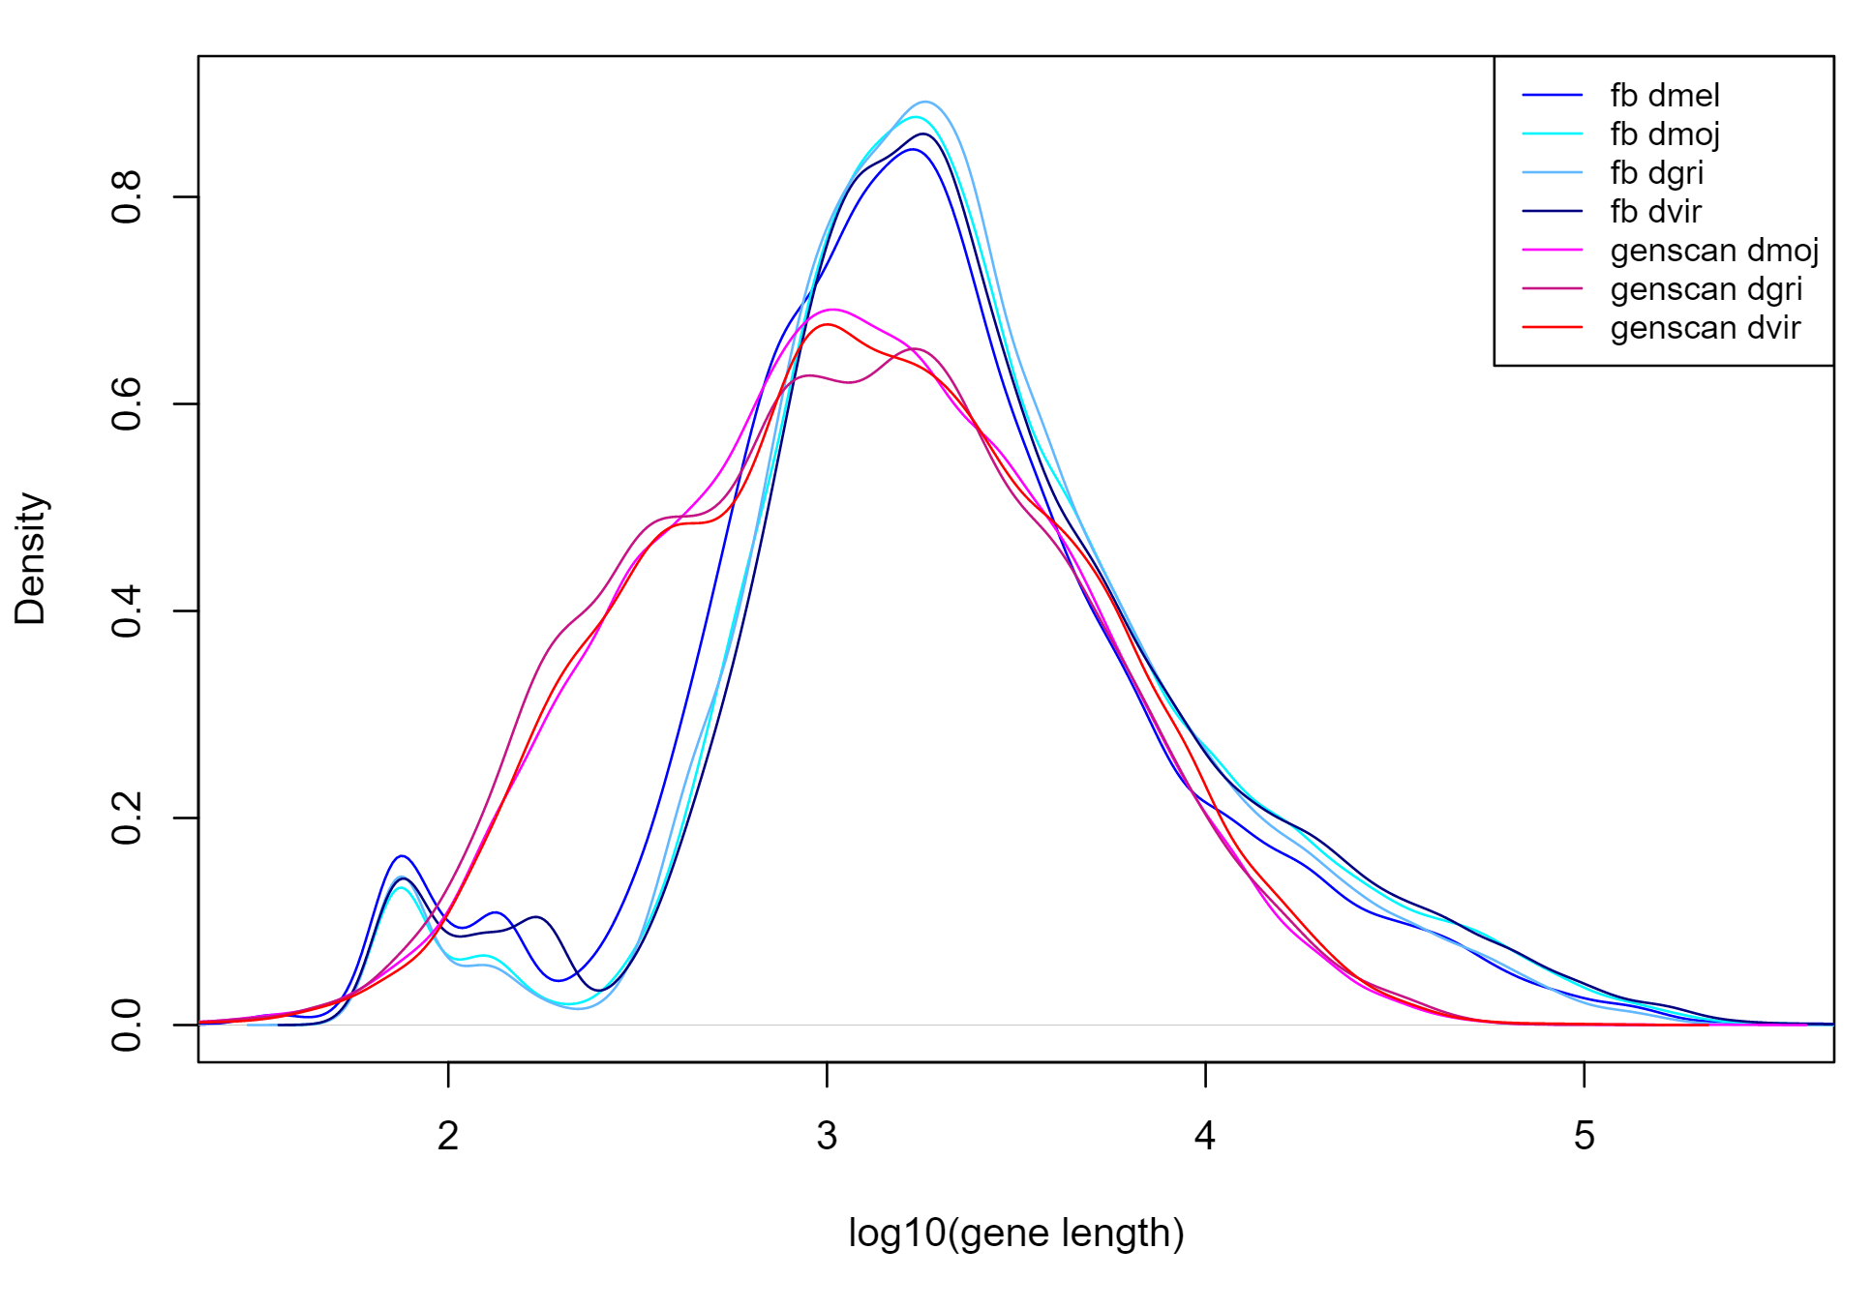
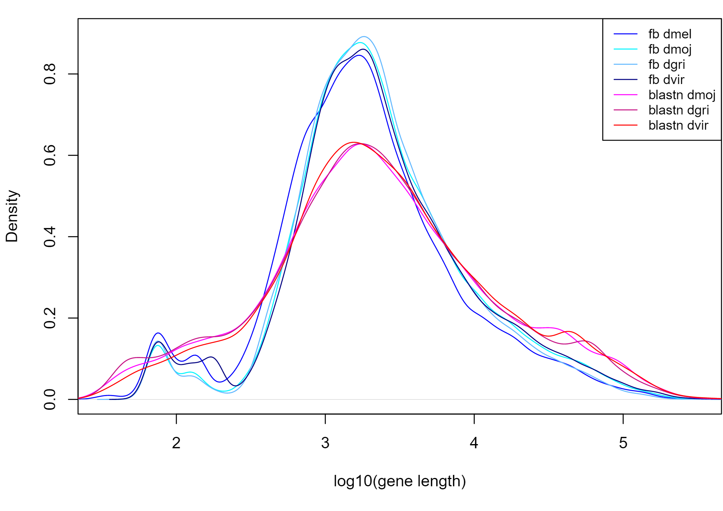
Gene length cross-species comparison
Distribution of gene length (Genscan)
Distribution of gene length (Blastn)
Notes:
Data is less clustered/centralised

Slide 22
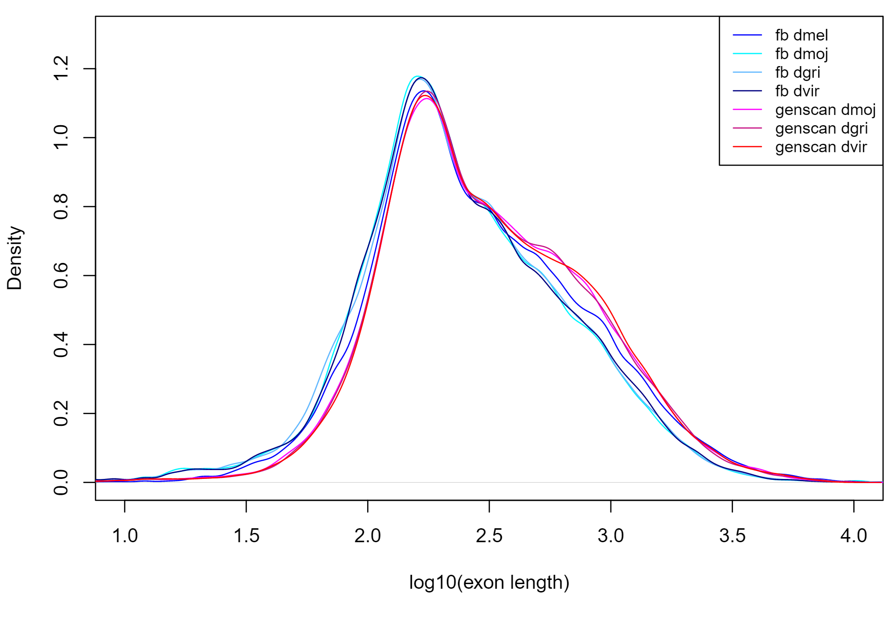
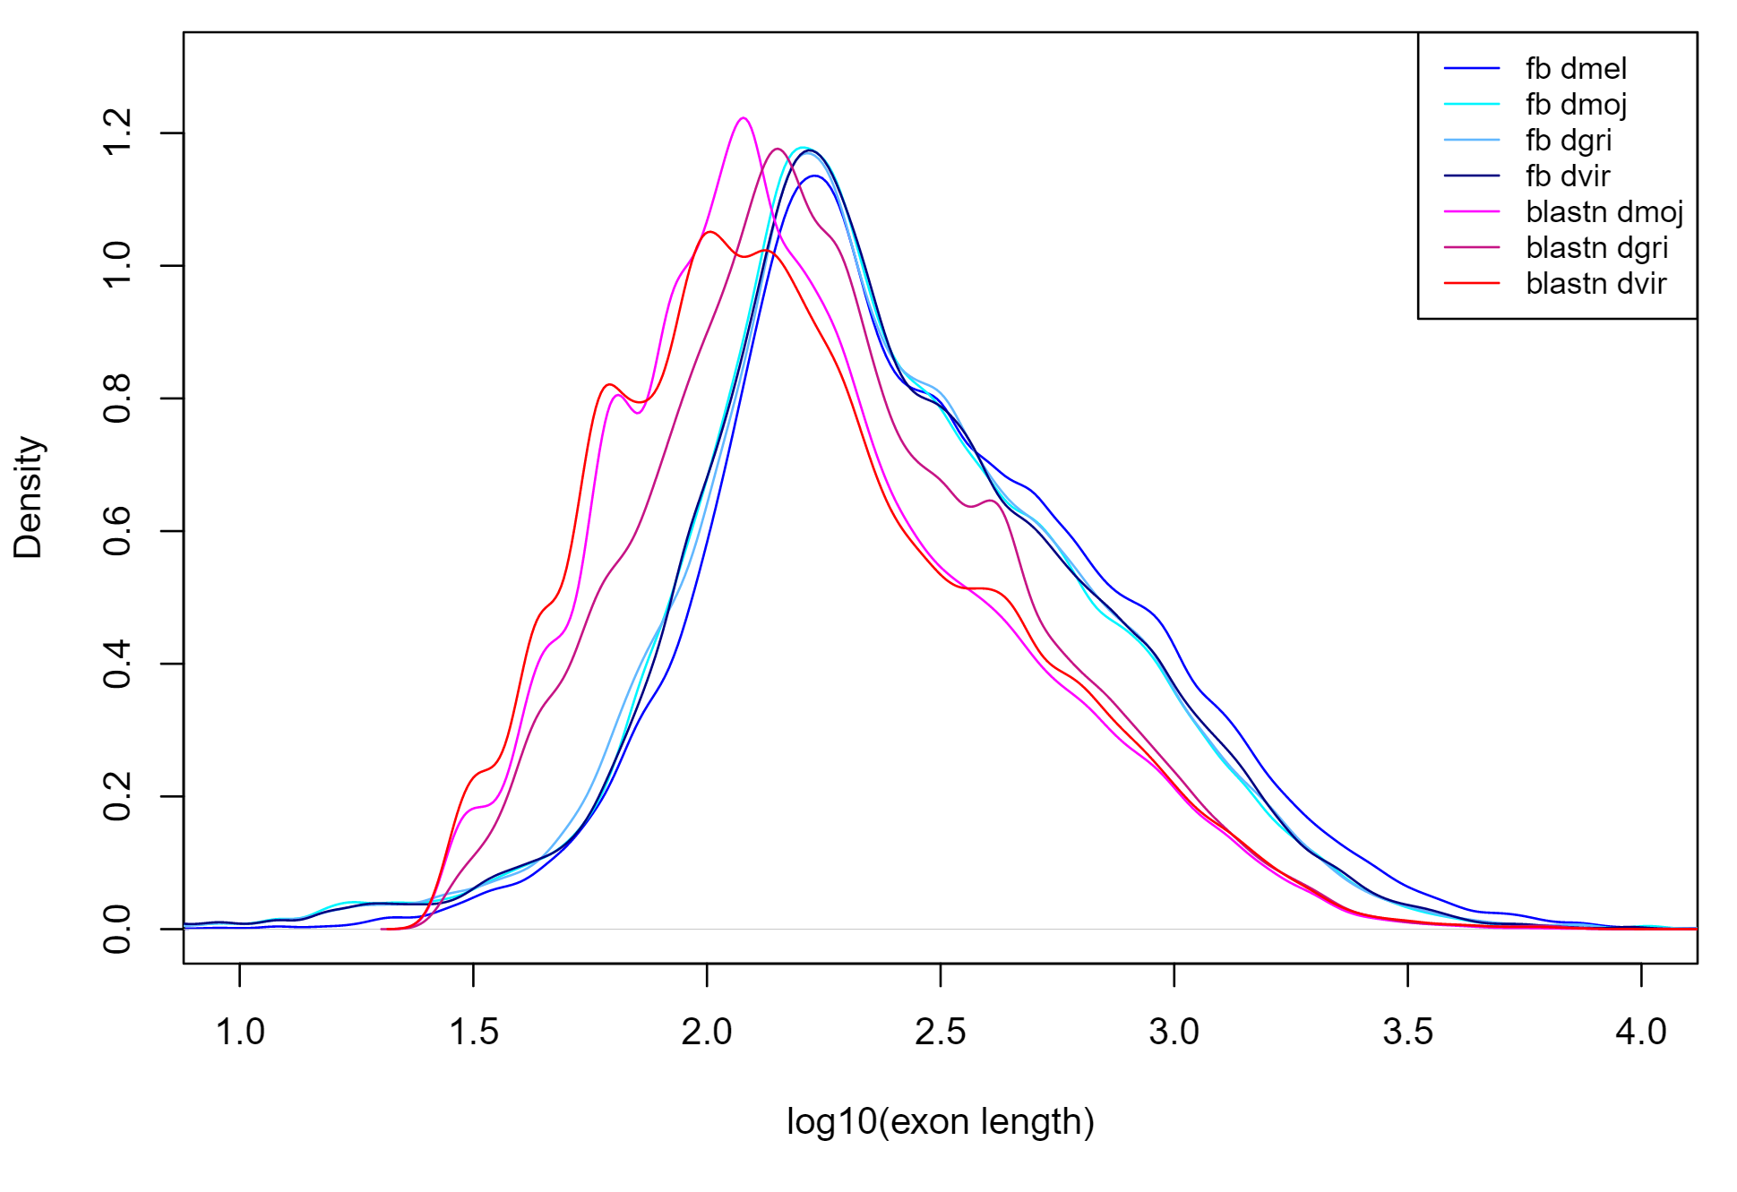
Exon length cross-species comparisons
Distribution of exon length (Genscan)
Distribution of exon length (Blastn)

Slide 23
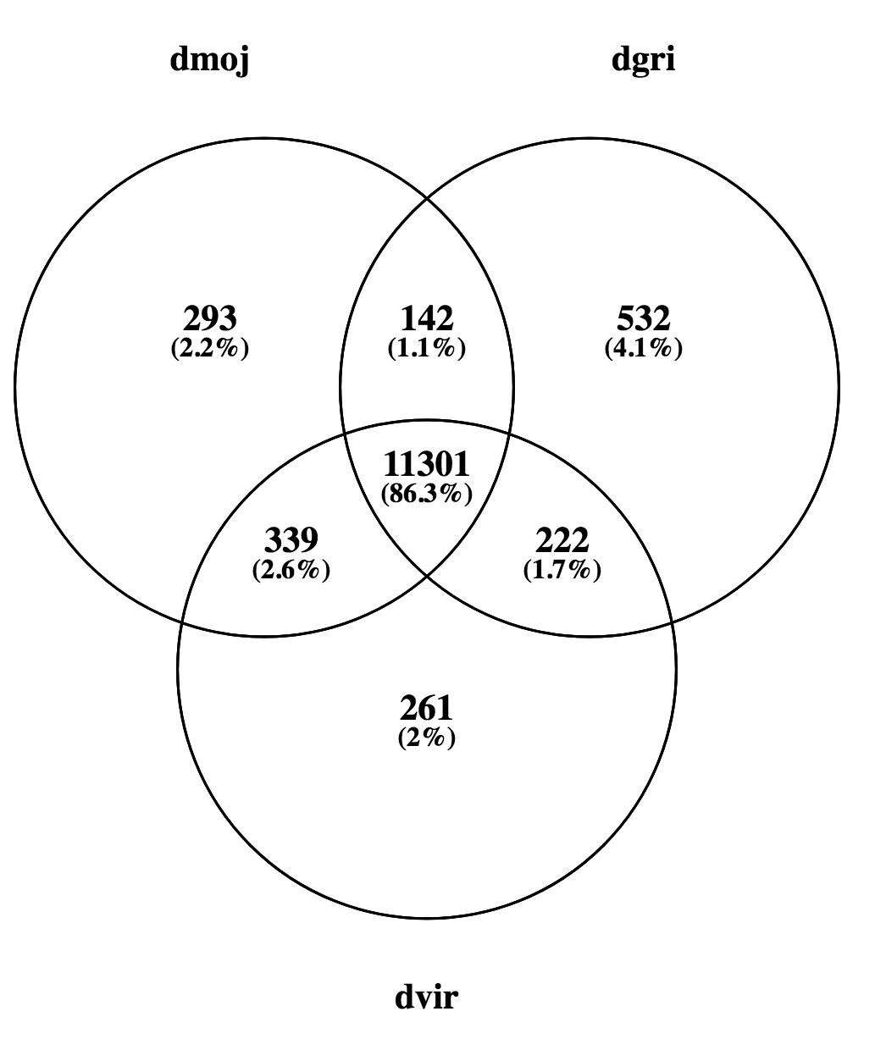
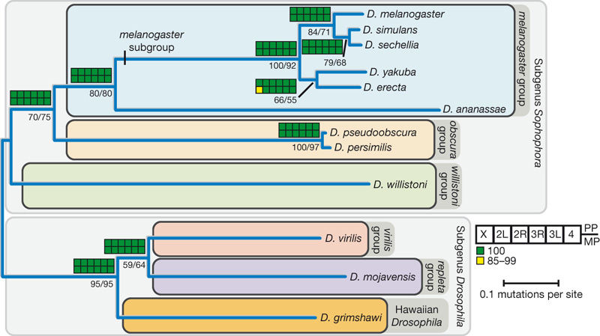
Venn Diagram - Gene overlapping from Blastn data

Slide 24
Conclusions
Both Genscan and Blastn/tBlastn have their advantages and disadvantages
Characteristics | Genscan | Blastn/tBlastn
Reference genome required | No | Yes
Functional annotations | No | Yes
Overprediction of gene number | Yes | No
Gene structure prediction | Yes | No
Isoform variants | No | Yes
An alternative method is to combine both methodologies (Twinscan)

Slide 25
References and code files
References:
1) Burge, C. and Karlin, S. (1997). Prediction of complete gene structures in human genomic DNA. Journal of Molecular Biology, 268(1), pp.78-94.
2) Drosophila 12 Genomes Consortium, (2007). Evolution of genes and genomes on the Drosophila phylogeny, Nature, 450, 203-218.
3) Korf I, Flicek P, Duan D, Brent M. (2001). Integrating genomic homology into gene structure prediction. Bioinformatics, 17 , 140-148.
4) Gelfand, M. S., Mironov, A. A., & Pevzner, P. A. (1996). Gene recognition via spliced sequence alignment. Proceedings of the National Academy of Sciences of the United States of America, 93(17), 9061–9066.
5) James T. Robinson, Helga Thorvaldsdóttir, Wendy Winckler, Mitchell Guttman, Eric S. Lander, Gad Getz, Jill P. Mesirov. (2011). Integrative Genomics Viewer. Nature Biotechnology, 29, 24–26.
6) L. Sian Gramates et al., FlyBase at 25: looking to the future, Nucleic Acids Research, Volume 45, Issue D1, 4 January 2017, Pages D663–D671
GitHub Address:
https://github.com/Cy1614/GIA

